Slide 1

Natural Language Processing (NLP) Application Capstone Project Automated Ticket Assignment 19th Apr 2020
Gaurav Walia
Karishma Dcosta
Kumari Pallavi
Lavanya Harry Pandian
Swati Tyagi
Group 3, Batch: Apr 2019 –Apr 2020
Project Guide: Sanjay Tiwary Program Manager: Anurag Shah

Slide 2
Capstone Project
Problem Statement
IT function in an organization ensures uninterrupted Business operations through Incident Management process.
These incidents are created by various stakeholders in IT Service Management Tool and are assigned to Service Desk teams
Project Goal
Goal of the project is to build a classifier that can classify the tickets by analyzing the text using Natural Language Processing(NLP) techniques in AIML
Solution
The solution is to build a classification model that can analyze the text and classify to appropriate Service Desk team.

Slide 3
Approach
Analyze and Understand the structure of data
Visualize data
Text preprocessing
Create word vocabulary and Tokens
Build a Classification model
Train the model
Test and fine tune the Model

Slide 4
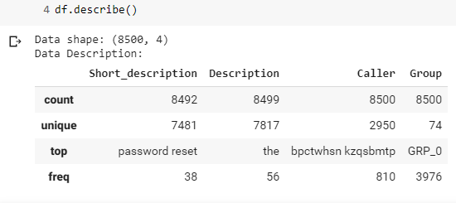
Data Exploration
The dataset has total 8500 records
There are missing values in short description and Description columns.
The maximum times the short description has been repeated is 38
The maximum times the Description has been repeated in 56
The maximum times the caller has repeated is 810
The maximum times a group is assigned ticket is 3976

Slide 5
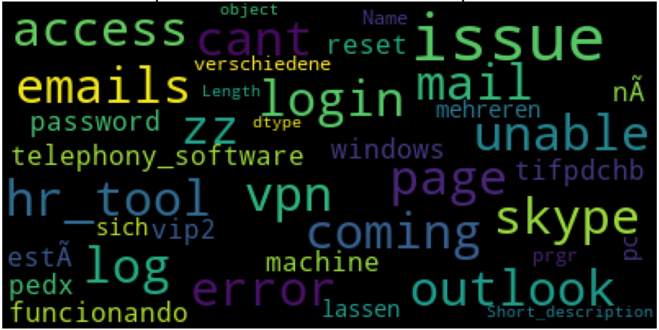
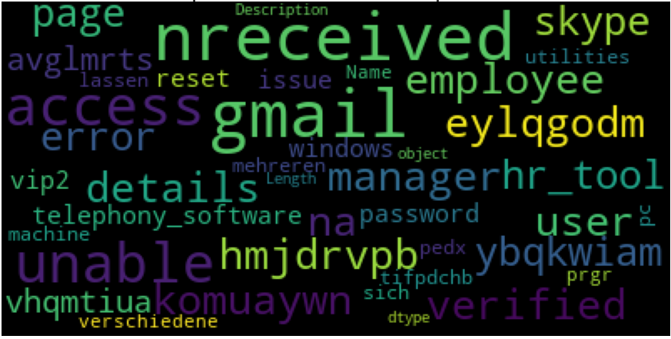
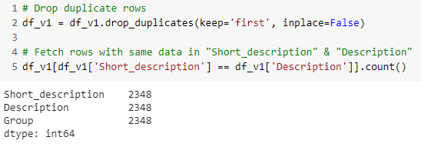
Analyzing Features
Most Frequent Words in Short Description Column
Most Frequent Words in Description Column
Checking to see if Description and Short_description columns have same data, we see that there are 2862 records that have exactly same data in both the columns.

Slide 6
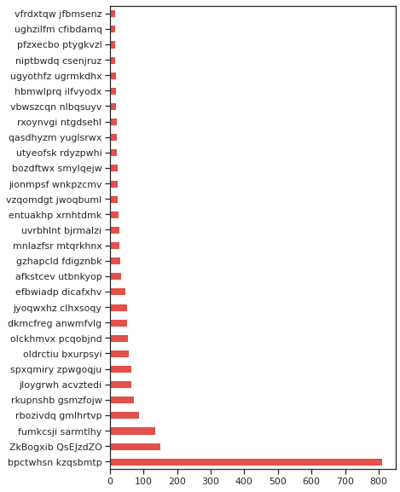
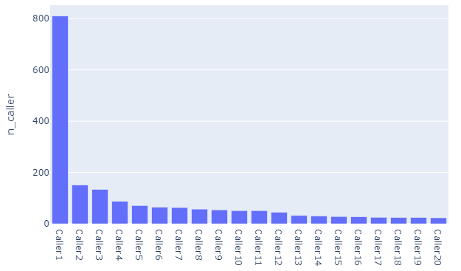
Caller Feature
One caller has reported 810 tickets
The distribution is skewed.
This disparity could be a batch job or an anomaly and should be considered for discussion with domain expert. We are not taking up further analysis of caller for this project.

Slide 7
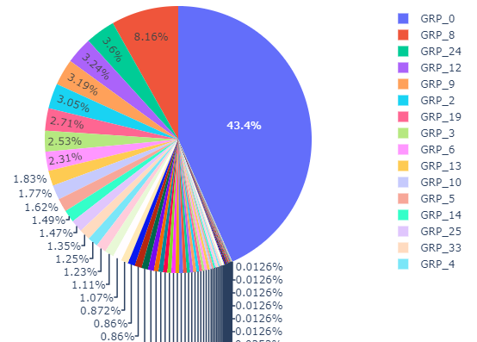
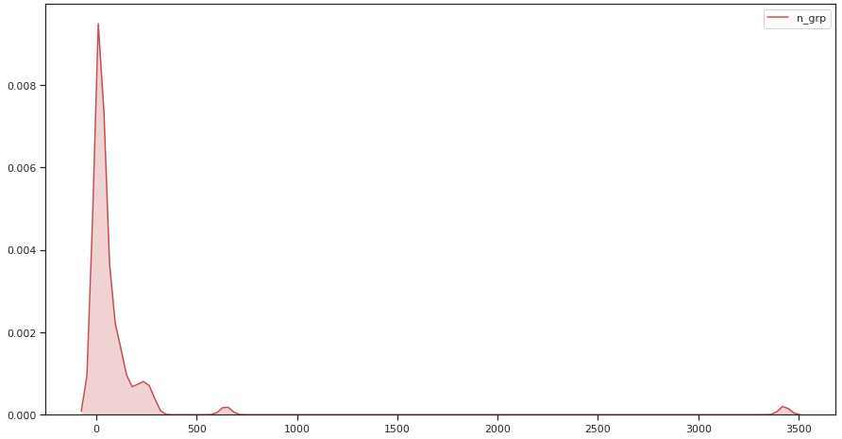
Group Feature
There are total of 74 groups to which tickets are assigned to. The ticket assignment is not symmetric and few groups have as minimum as one ticket assigned. The data has a class imbalance.

Slide 8
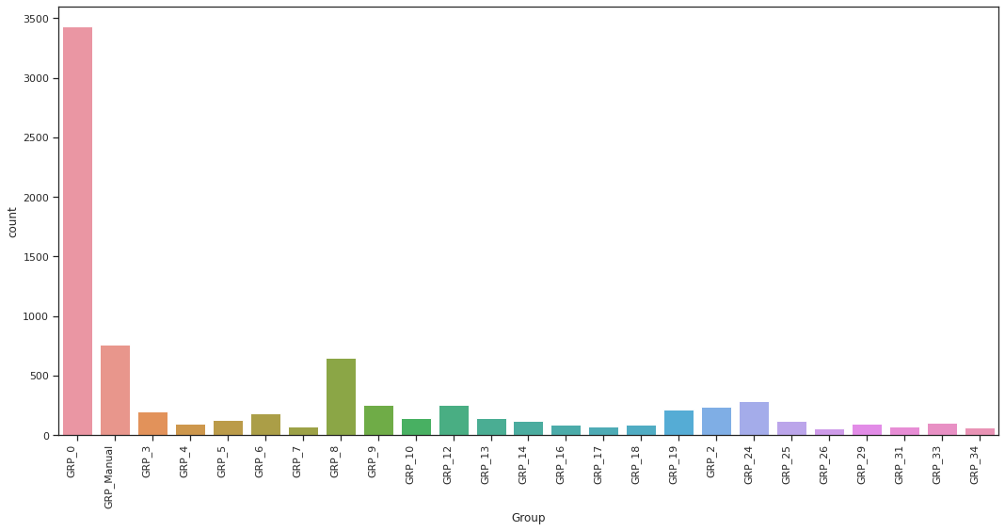
Address Imbalance
To address imbalanced class in this project, we merge minority classes into one group. Where number of tickets in the category is less than specified frequency, we mark them into "GRP_Manual".
After grouping the less assigned class (minority class) into one group (GRP_Manual), we now have 25 groups
All "GRP_Manual" tickets need be triaged manually, until the model has enough data to categorize them automatically. Merging the minority class will improve the F1 score as we classify less assigned class into a group.

Slide 9
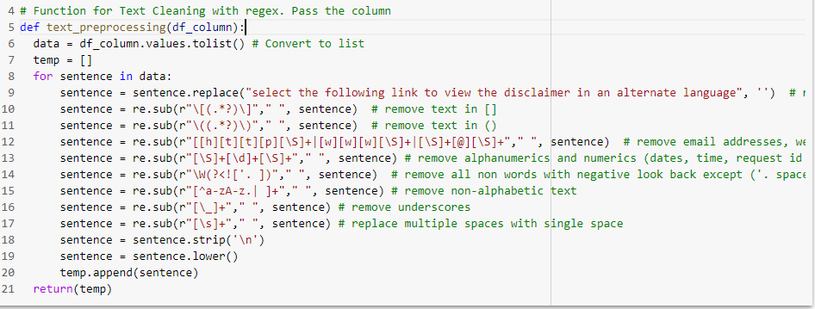
Text Preprocessing
By Regular Expression, we clean text for
Insignificant text – remove email addresses, test in braces, numerical/alpha numerical and symbols
Punctuations- all punctuations, extra spaces, and special characters are removed
Capital case - a mixture of uppercase and lowercase words are changed to lowercase

Slide 10
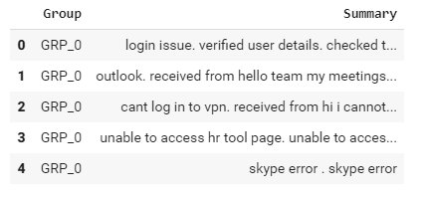
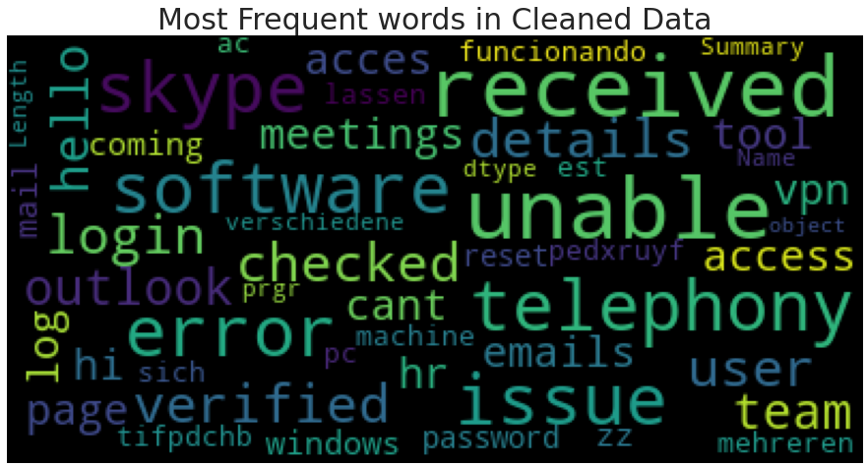
Cleaned Text
The preprocessed data is then concatenated into a single column called ‘Summary’
Word cloud of text after cleaning and concatenating Short Description and description columns

